Slide 1
Mahalanobis Distance

Slide 2
Measure Distances in Multivariate world
Challenges in measuring Distances in Multivariate world
Each dimension may have different variance
Dimensions with larger spread will dominate the distance
Unfair to dimension with smaller spread
Features need to be scaled to have unit standard deviation
Impact of Correlation among dimensions
Imagine set up with N features
If multiple features have non-zero correlation
They don’t add value worth N features.
Pairs of such features need to be penalised
Penalty proportional to the covariance

Slide 3
Covariance Matrix ∑
Captures artifacts of the data
variances along the diagonal elements
Covariance along Non diagonal elements
Inverse of the covariance matrix
Apply this matrix in distance calculation
It appropriately calibrates the importance of features

Slide 4
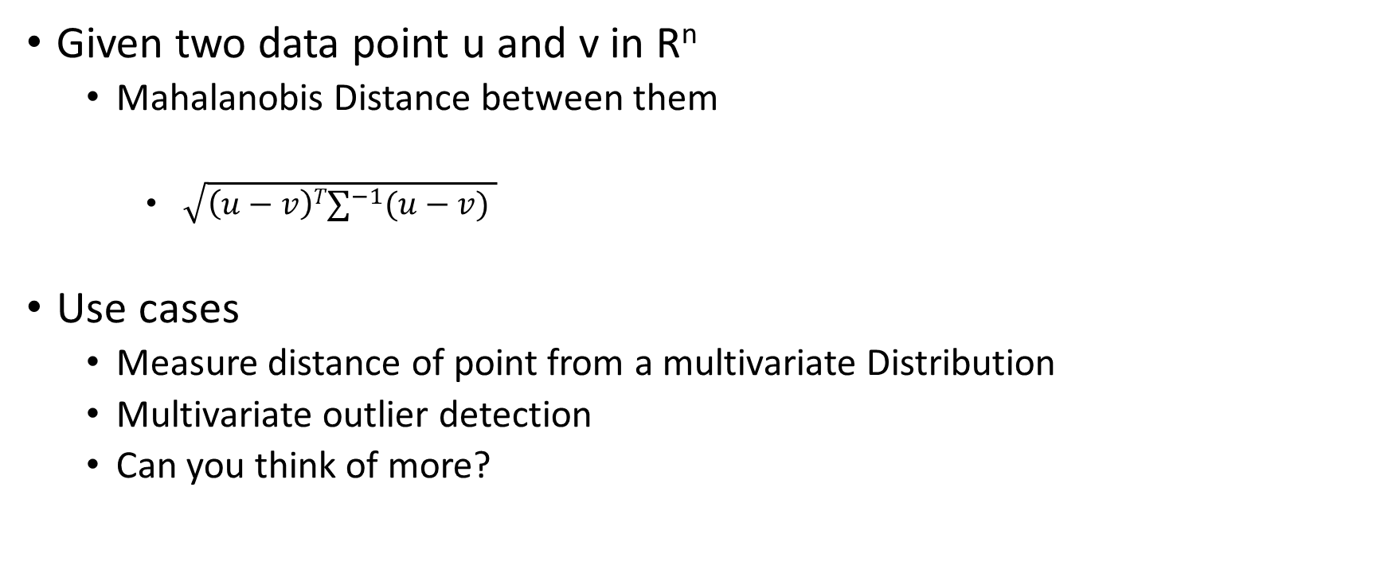
Mahalanobis Distance
Given two data point u and v in R^{n}
Mahalanobis Distance between them
$\sqrt{\left(u−v\right)T∑^{−1}(u−v) }$
Use cases
Measure distance of point from a multivariate Distribution
Multivariate outlier detection
Can you think of more?

Slide 5
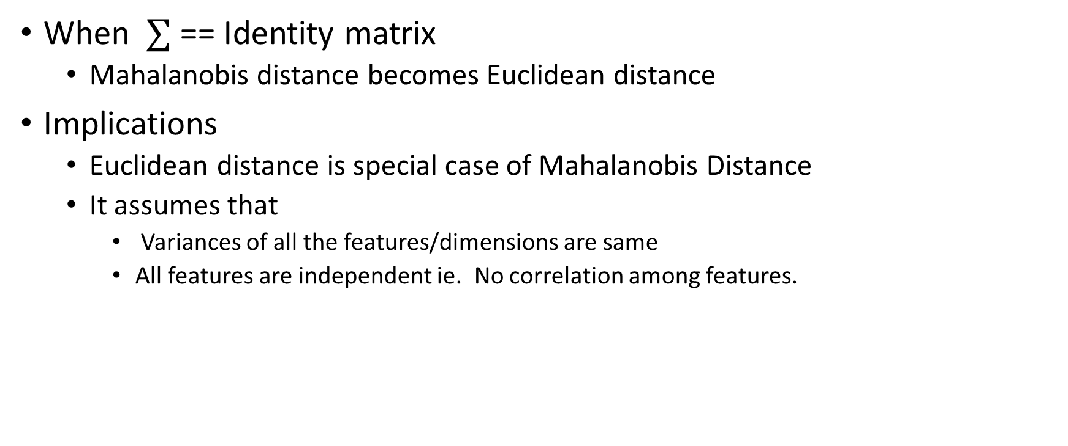
Relationship with Euclidean Distance
When $∑$ == Identity matrix
Mahalanobis distance becomes Euclidean distance
Implications
Euclidean distance is special case of Mahalanobis Distance
It assumes that
Variances of all the features/dimensions are same
All features are independent ie. No correlation among features.

Slide 6
Practice Questions
Explain relationship between Mahalanobis distance and Euclidean distance.
Design an algorithm to filter multivariate outliers using mahalanobis distance.
Explain issues with Euclidean distance while detecting multivariate outliers.

